Slide 1



BATCH NO 26
TITLE :
DDOS ATTACK DETECTION USING
ENSEMBLED BASED APPROACH
Guided By:
Dr.T.M.Saravanan MCA., M.phil.,
Department Of MCA- PG
Team Members
PRABHU S (23MCR068)
SANTHIYA S (23MCR083)
YUVAPRIYAN K M(23MCR126)

Slide 2
TABLE OF CONTENT
Abstract
Introduction
Literature review
Problem identification
Dataset Description
Proposed Methodology
Flow Chart of Proposed Model
Evaluation metrics
Conclusion and Enhancement
Reference

Slide 3
ABSTRACT
The rapid growth of internet has greater impact over the day-to-day essential services like banking, power and in every sector.
The internet security is always a challenging problem because the counts of attacks are surprisingly increasing every day.
The DDoS detection is effectively done in many ML and DL. But the existing models unable to recognize the distinct and dynamic behavior of DDoS attacks.
This project proposes a algorithms for DDoS attack detection using ensemble approach.
Then the ensemble model is trained using the selected optimal features for the classification of DDoS attack detection.

Slide 4
INTRODUCTION
A Distributed Denial of Service (DDoS) attacks to prevent legitimate users from accessing an online service or applications by suspending the hosting servers.
To generate the attack, the attackers use numerous compromised or controlled sources to generate massive amounts of packets or requests.
These requests cause the target system to become overburdened, causing it to operate poorly and become inaccessible to legitimate users.

Slide 5
LITERATURE REVIEW
S.no | Name of the paper | Author Name | Year of publication | Concepts/Algorithm used | Future work
1 | Detection of Different DDoS Attacks Using Machine Learning Classification Algorithms | Kishore Babu Dasari et al | 2021 | Logistic regression, Decision tree, Random Forest, K-Nearest Neighbor, Naive Bayes, and AdaBoost | The idea of next research would be to use feature selection to reduce data and detect DDoS attacks using low-cost hardware.
2 | Machine Learning-Based Classification and Prediction Technique for DDoS Attacks | Ismailetal | 2022 | Random forest | we will investigate how non-supervised learning algorithms will affect the DDoS attacks detection, in particular, we non-labeled datasets are taken into account.
3 | Machine-Learning-Based DDoS Attack Detection Using Mutual Information and Random Forest Feature Importance Method | Moa Alduailij etal | 2022 | Random Forest (RF), Gradient Boosting (GB), Weighted Voting Ensemble (WVE), K Nearest Neighbor (KNN), and Logistic Regression (LR) | In the future, we may use wrapper feature selection methods, such as sequential feature selection, with neural networks, for DDoS and other attack detection.

Slide 6
LITERATURE REVIEW
S. No | Name of the paper | Author | Year of publication | Concepts/Algorithm used | Future work
4 | DDOS attack detection in cloud computing based on ensemble feature selection and deep learning. | Yousef Sanjalawe | 2023 | Convolutional Neural Network(CNN), Support Vector Machine(SVM), | It is suggest the future studies expand the current study to ensure the detection of network and anomaly misuses on streaming data in real time.
5 | DDOS attack detection using swarm optimized random forest classification. | R.Sarath Babu, K.Radhika | 2023 | Grey Wolf Optimization(GWO), Intruder Detection System(IDS),Random Forest(RF),Stochastic Gradient Descent(SGD). | In this paper , a modified GWO based feature selection is used along with RF for attack detection. The feature that produces the highest accuracy are chosen using a GWO method.
6 | A modified grey wolf optimization algorithm for an intrusion detection system. | Abdullah Alzaqebah | 2022 | Grey Wolf Optimization(GWO),Genetic Algorithm(GA),Harris Hawks Optimization(HHO). | For future directions, the transfer function is an essential part of binarizing the continuous search space, such as X-shaped transfer function.

Slide 7
PROBLEM IDENTIFICATION
The rapid growth of internet has greater impact over the day-to-day essential services like banking, power and in every sector.
The internet security is always a challenging problem because, the counts of attacks are surprisingly increasing every day.
DDOS attack targets the availability of services in the internet.
Some DDoS attacks have common effective methods and some attacks have different effective methods.

Slide 8
DATASET DESCRIPTION
Dataset Name: CIC2019 Dataset
The data contains the following fields,
Source Port
Destination Port
Protocol
Flow Duration
Total Fwd Packets
Total Length of Fwd Packets
Min Packet Length
Max Packet Length
Average Packet Size
act_data_pkt_fwd
min_seg_size_forward
Attack_type

Slide 9
PROPOSED METHODOLOGY
We have proposed the machine learning algorithms to make sure that the accuracy of the classification model gets satisfied for this detection.
The machine learning algorithms are Support Vector Machine, KNN Algorithm and Random Forest Algorithm.
K-Nearest Neighbour is one of the simplest machine learning algorithm which is based on supervised learning technique.
Random Forest Algorithm is also supervised learning technique that is used for both classification and regression problems.

Slide 10
SUPPORT VECTOR MACHINE
Support Vector Machine (SVM) is one of the supervised learning algorithm which is used for both classification as well as regression.
The goal of this SVM algorithm is used to create best fitting line into the model called hyperplane.
It chooses the vectors that are used to creating the hyperplane.
The data points that are the closest to the hyperplane and affect the position of the hyperplane is known as support vector.

Slide 11
SUPPORT VECTOR MACHINE
Algorithm
Input: Dataset
Output: Accuracy and validity
1 start
2 input the dataset
3 classify the dataset
4 apply the SVM with kernel functions
5 specify the hyperplane
6 if obtained Accuracy and validity is not satisfied then repeat step 4
7 end

Slide 12
KNN ALGORITHM
KNN is a classiﬁcation approach that classiﬁes test data observations which is based on how close they are to nearest class neighbors.
KNN is used as a supervised learning approach, and KNN is used to identify the nearest neighbors.
It is based on a non parametric approach to classify samples.
The distance between separate points on the input vector is determined, and the unlabeled point is, then, allocated to the neighboring class K. K is the main parameter in the KNN classiﬁcation.
KNN is easy to understand, when there are few predictor variables. For the creation of models with normal data types, such as text, KNN is used.

Slide 13
KNN ALGORITHM
Input: The training set D, test object x, category label set C
Output: The category cx of test object x, cx belongs to the C
1 begin
2 for each y belongs to D do
3 calculate the distance D(y, x) between y and x
4 end for
5 select the subset N from the data set D, the N contains k training samples which are the k nearest neighbors of the test sample x
6 calculate the category of x
7 end

Slide 14
RANDOM FOREST REGRESSION
Random forest is a collection of decision trees trained on different dataset subsets and then averaged to increase predictive accuracy.
It is created randomly with a collection of decision trees.
Each node selects a set of features at random to calculate the outcome.
The output of individual decision trees is combined in the random forest to produce the outcome.

Slide 15
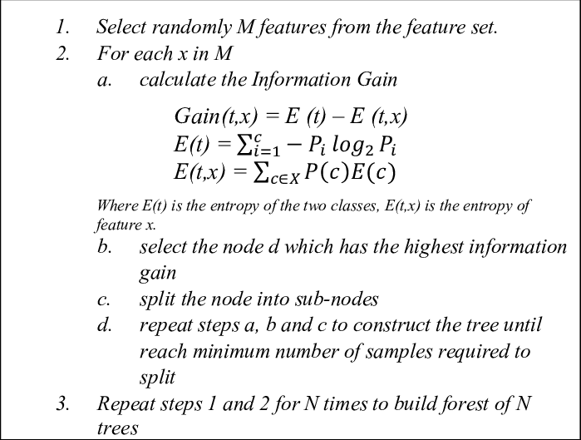
RANDOM FOREST REGRESSION
Algorithm

Slide 16
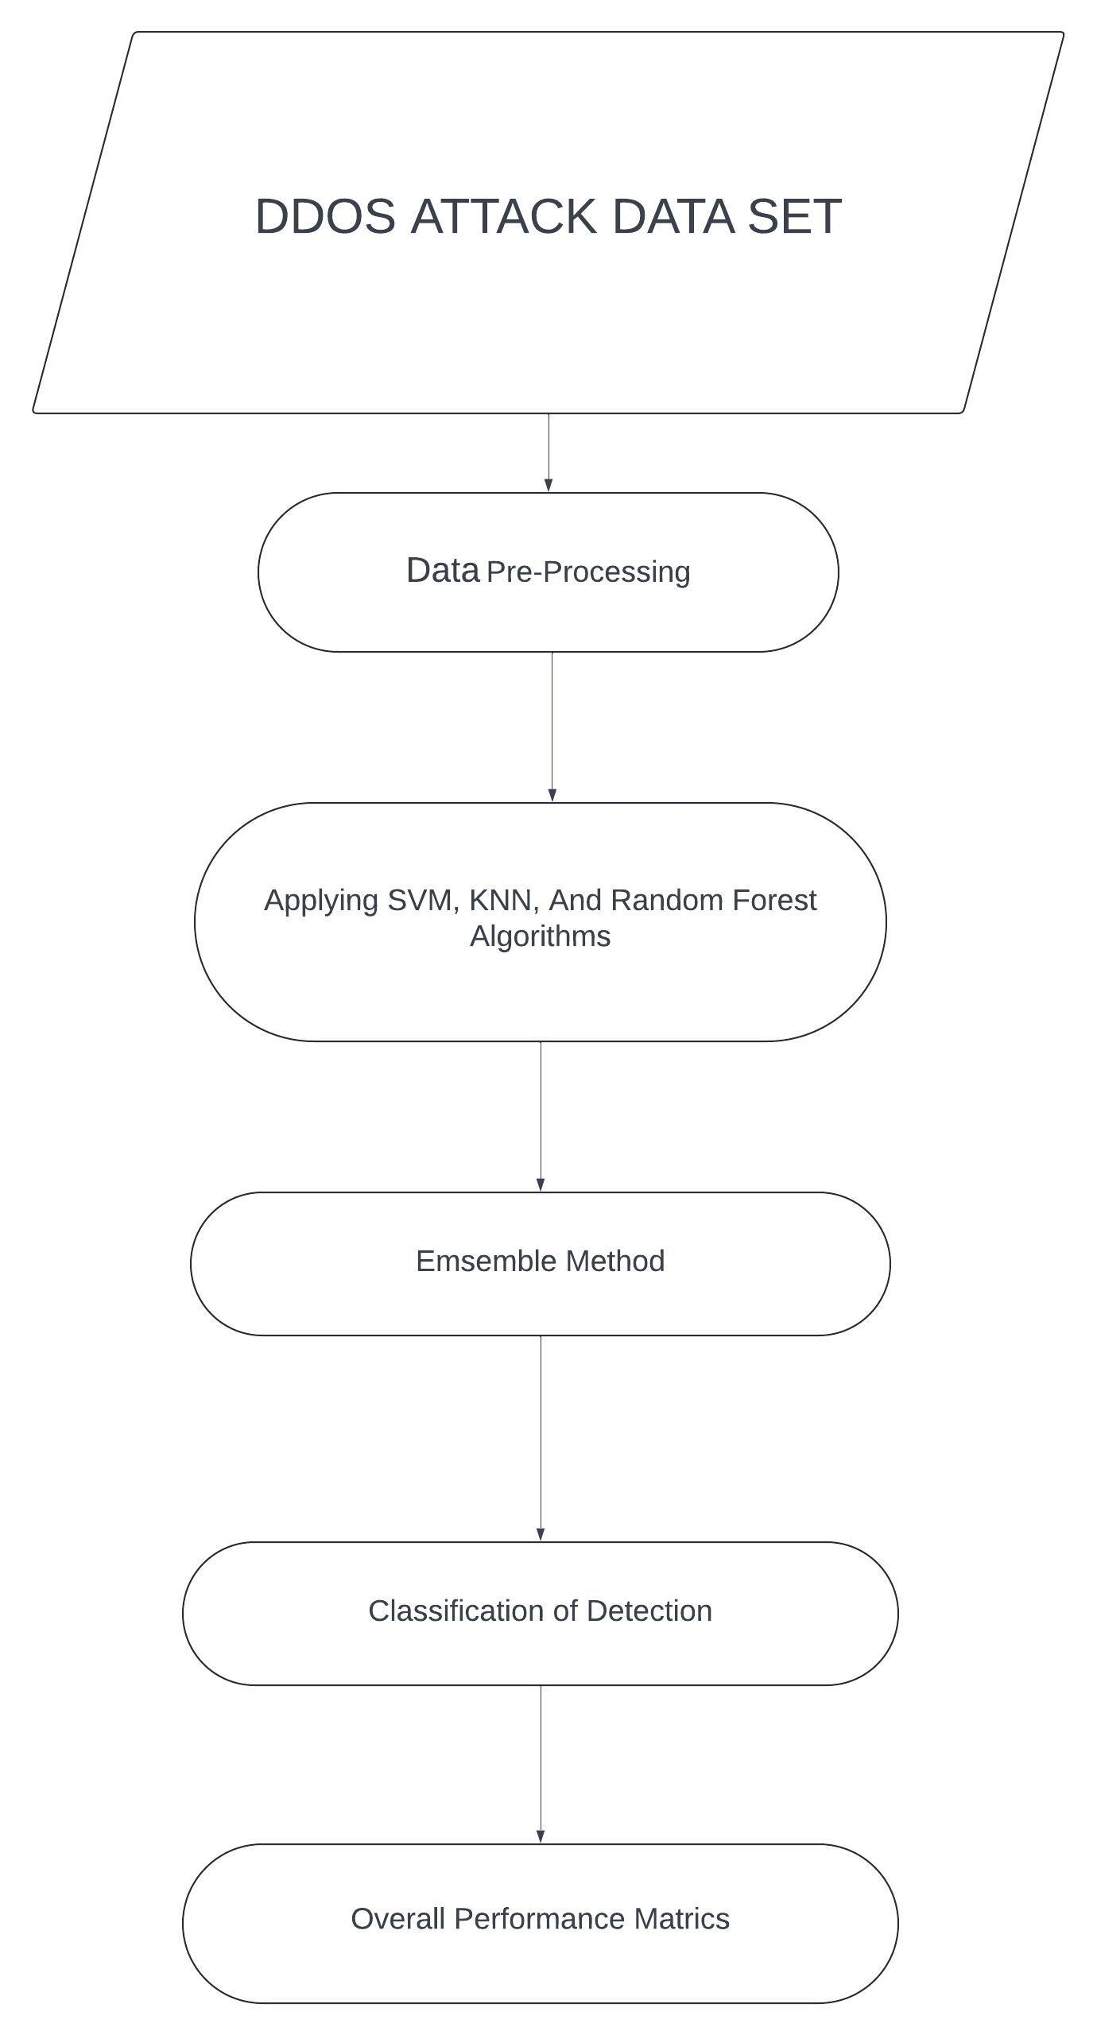
WORK FLOW OF PROPOSED MODEL

Slide 17
ENSEMBLE LEARNING
Ensemble methods are techniques that aim at improving the accuracy of results in models by combining multiple models instead of using a single model.
These combined models increase the accuracy of the results significantly.
This has boosted the popularity of ensemble methods in machine learning.
The models run in parallel and are independent of each other.
The final predictions are determined by combining the predictions from all the models.

Slide 18
EVALUATION METRICS
Algorithms | Accuracy
Support Vector Machine | 88.42%
Random Forest Classifier | 90.58%
KNN Algorithm | 87.92%
Bagging Ensembling | 89.75%

Slide 19
CONCLUSION AND ENHANCEMENT
This research represented a comparison of the performance of three machine learning classification algorithms on DDoS attacks datasets.
The most common effective DDoS attack detection method for all DDoS attacks has yet to be identified.
The algorithms uses Support Vector Machine, Random Forest regression and KNN algorithm shows good results.
By combining these three models with ensembling learning algorithm gets more increased accuracy for this classification model.

Slide 20
FUTURE ENHANCEMENT
In this paper, classification algorithms applied to different individual DDoS attack datasets get the best scores in all metrics with google colab.
This configuration is more expensive. All datasets are big data size.
The idea of next research would be to use feature selection to reduce data and detect DDoS attacks using low-cost hardware.

Slide 21
REFERENCES
[1] Kishore Babu Dasari et al, “Detection of Different DDoS Attacks Using Machine Learning Classification Algorithms” International Information and Engineering Technology (IIET), Rochester, NY, October 2021.
[2] Ismail et al, “Machine Learning-Based Classification and Prediction Technique for DDoS Attacks”,IEEE, February, 2022.
[3] Mona Alduailij et al, “Machine-Learning-Based DDoS Attack Detection Using Mutual Information and Random Forest Feature Importance Method,” MDPI, May 2022 .
[4] Andrés Chartuni et al, “Multi-Classiﬁer of DDoS Attacks in Computer Networks Built on Neural Networks,” MDPI , 2021.
[5] Lu Zhou et al, “A Feature Selection based method for DDoS attack flow classification.”, ELSEVIER, February 2022.

Slide 22
THANK YOU !

